Slide 1
Unsupervised Learning

Slide 2
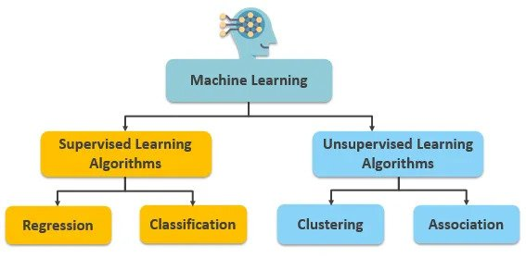

Slide 3
Definition
Unsupervised learning: A type of machine learning where the model is given unlabeled data and must find patterns or relationships on its own. Generally, this is data driven.
In unsupervised learning, the algorithms are left to themselves to discover interesting structures in the data- we do not label.
The data given to unsupervised algorithms is not labelled, which means only the input variables (x) are given with no corresponding output variables.

Slide 4
Brief Definition Recap
Feature: An input variable used in making predictions.
Predictions: A model’s output when provided with an input example.
Example: One row of a dataset. An example contains one or more features and in the case of a supervised learning approach, a label.
Label: Result of the feature. (Heart Disease or No Heart Disease in our supervised learning example)
Training Data: Data that we provide to a learning model/algorithm to draw its mathematical consequences from
Testing Data: The data that we split off in the beginning and intentionally excluded from the training data so that we could test our algorithm later.

Slide 5
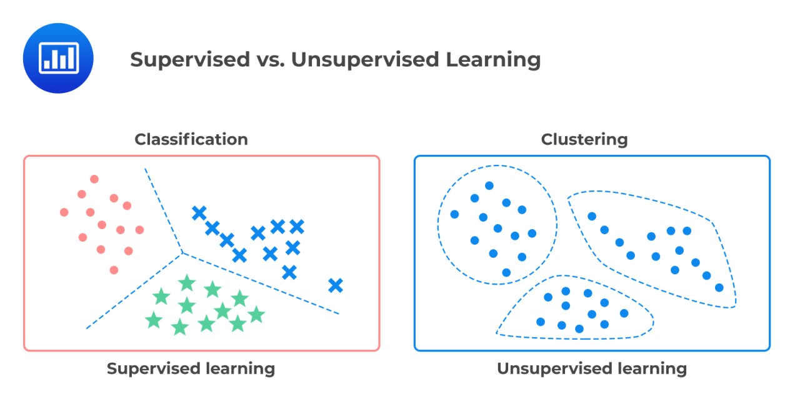
Classification (supervised) vs. clustering (unsupervised)

Slide 6
Types of unsupervised learning
Clustering: An unsupervised learning technique where the goal is to group similar data points together based on certain characteristics. (Discrete)
Association Rule Mining: a technique used to uncover relationships between different items or variables in a dataset. The primary focus is on identifying sets of items that frequently occur together. (Discrete)

Slide 7
General steps for unsupervised learning
Define the problem
Collect and prepare the data
Explore and pre-process the data
Dimensionality Reduction (if applicable)
If the dataset is big, consider applying dimensionality reduction techniques to simplify the data while preserving essential information.
Feature scaling (if applicable)
Standardize or normalize features if the algorithm being used is sensitive to the scale of the input features.
Choose an Unsupervised Learning Algorithm
Select an algorithm based on the nature of the problem and the desired outcomes.
Train the model (this doesn't mean labelling, rather iterate)
Tune the model (if applicable).
Explore results and patterns
Visualization (if applicable)
Sometimes we want to represent our data in lower-dimensional spaces to display the clustering effects for example
Make predictions

Slide 8
Common Pre-Processing Steps for both supervised and unsupervised learning
Data cleaning
Data scaling/normalization
Handling of categorical data (Female -> 0, Male ->1)
Feature engineering
Dimensionality reduction
Data splitting
Handling Time Series Data:
Time series data has temporal dependencies that require specific considerations.
Handling of redundant features
Redundant features can introduce multicollinearity, affecting the stability of models like linear regression

Slide 9
Algorithms for unsupervised learning (Clustering)
K Means:
Divides the dataset into a predefined number of clusters (k) by minimizing the sum of squared distances between data points and the centroid of their assigned cluster.
Example Use Case: Customer segmentation based on purchasing behavior.
Hierarchical Clustering:
Builds a hierarchy of clusters by either starting with each data point as a separate cluster (agglomerative) or starting with one cluster containing all data points (divisive) and iteratively merging or splitting clusters.
Example Use Case: Taxonomy of species based on genetic similarity.
DBSCAN (Density-Based Spatial Clustering of Applications with Noise):
clusters data points based on their density, forming clusters where data points are close to each other and have a sufficient number of neighbors. One subset algorithm that extends DBSCAN is OPTICS.
Mean Shift:
Assigns each data point to the cluster whose mean it converges to, allowing clusters to adapt to the shape of the data distribution.
More can be found on Day 1 slides.

Slide 10
Algorithms for unsupervised learning (Association)
Apriori algorithm
One of the most well-known algorithms for association rule mining, Apriori uses a breadth-first search strategy to discover frequent itemsets in a transaction database and generate association rules.
Use case: Market basket analysis to identify common purchasing patterns in retail transactions
FP-Growth (Frequent Pattern Growth)
An often more efficient alternative to Apriori, FP-growth constructs a tree structure (FP-tree) to represent frequent itemsets and mines association rules based on this structure.
Eclat (Equivalence Class Transformation) Algorithm:
Eclat is another algorithm for frequent itemset mining that uses a depth-first search strategy to discover frequent itemsets and generate association rules.
More can be found on Day 1 Slides.

